Slide 1
Huffman Coding
Material Prepared by
Dr. N. Subhash Chandra from Web resources

Slide 2
Applications
Compress the files for transmission.
Uses statistical coding
More frequently used symbols have shorter code words
Works well for text and fax transmissions

Slide 3
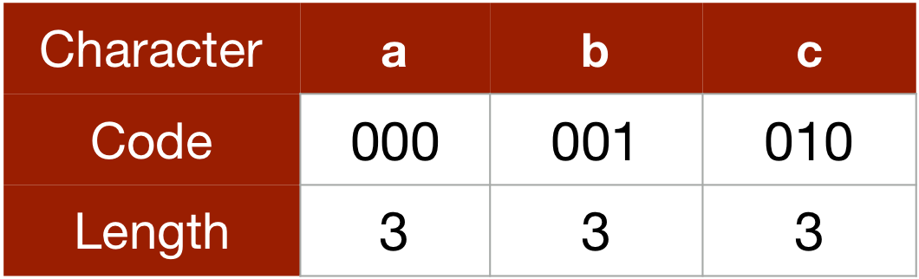
For example: Assign 'a' as 000 and 'b' as 001,
the length of the codeword for both the characters are fixed i.e., both 'a' and 'b' are taking 3 bits.
Huffman code doesn't use fixed length codeword for each character and assigns codewords according to the frequency of the character appearing in the file.
Huffman code assigns a shorter length codeword for a character which is used more number of time (or has a high frequency) and a longer length codeword for a character which is used less number of times (or has a less frequency).

Slide 4
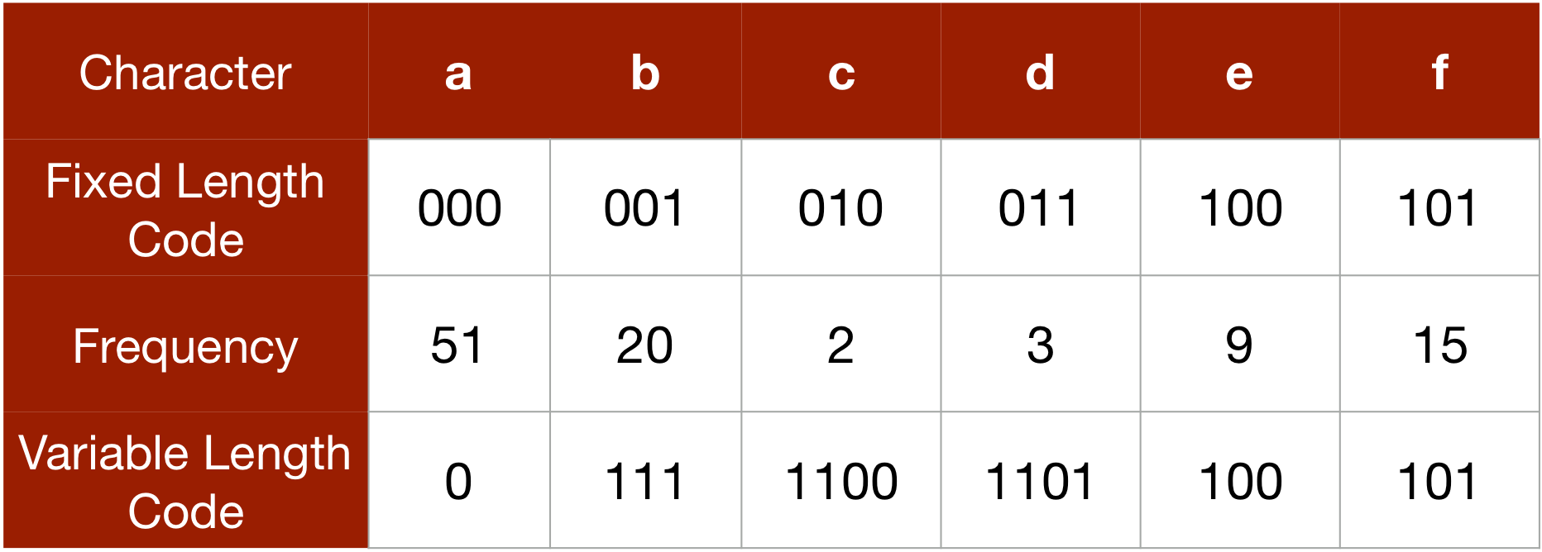
In this example: 'a' is appearing 51 out of 100 times and has the highest frequency, 'c' is appearing only 2 out of 100 times and has the least frequency. Thus, we are assigning 'a' the codeword of the shortest length i.e., 0 and 'c' a longer one i.e., 1100.
Fixed length 100*3 = 300 bits
Variable length 51*1 + 20*3 + 2*4 + 3*4 + 9*3 + 15*3 = 203 bits
Prefix codes: In variable length codeword, we only use such code which are not the prefix of any other character and these codes is known as prefix codes.
For example, if we use 0, 1, 01, 10 to represent 'a', 'b', 'c' and 'd' respectively (0 is prefix of 01 and 1 is prefix of 10), then the code 00101 can be translated into 'aabab', 'acc', 'aadb', 'acab' or 'aabc'. To avoid this kind of ambiguity, we use prefix codes.

Slide 5
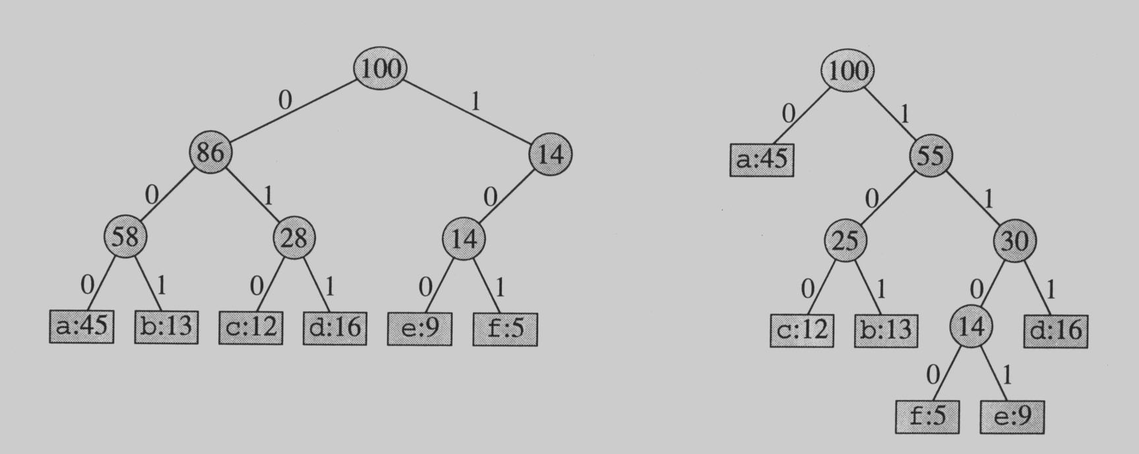
Prefix Codes
No encoding of a character can be the prefix of the longer encoding of another character, for example, we could not encode t as 01 and x as 01101 since 01 is a prefix of 01101
By using a binary tree representation we will generate prefix codes provided all letters are leaves

Slide 6
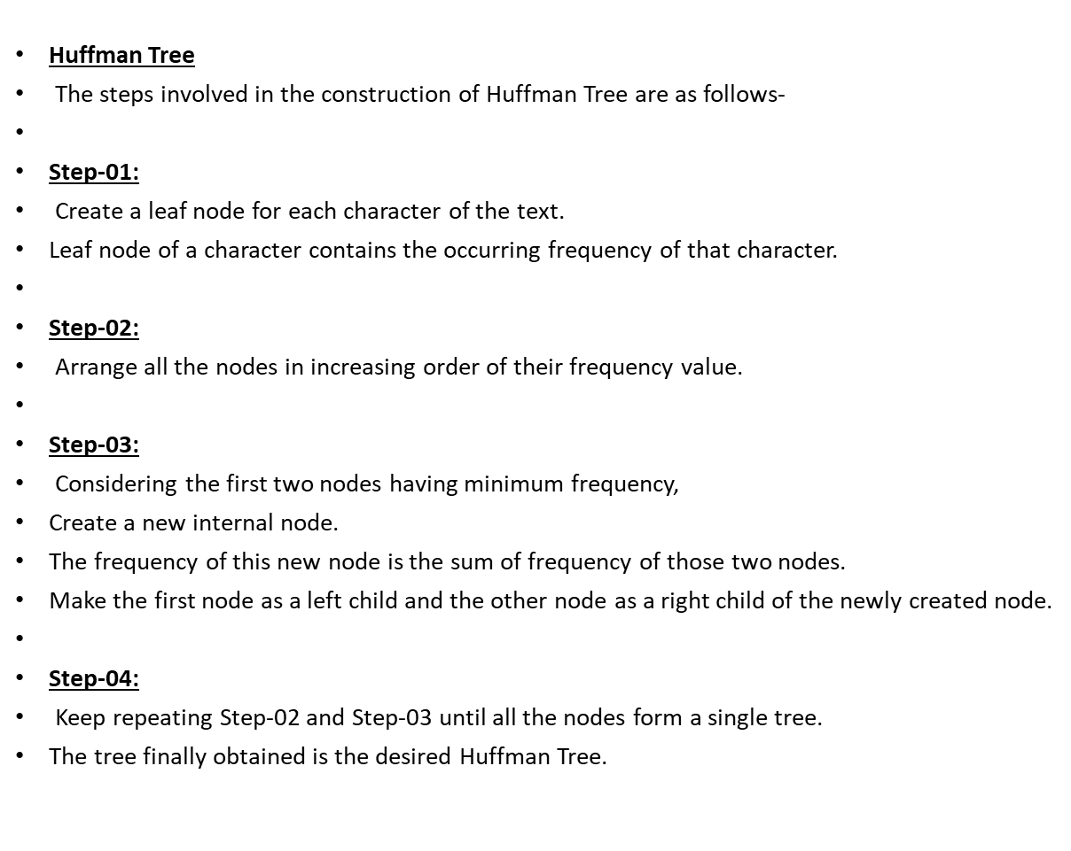
Procedure for Huffman tree

Slide 7
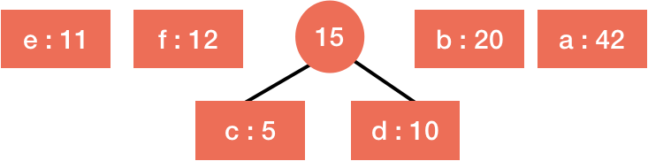
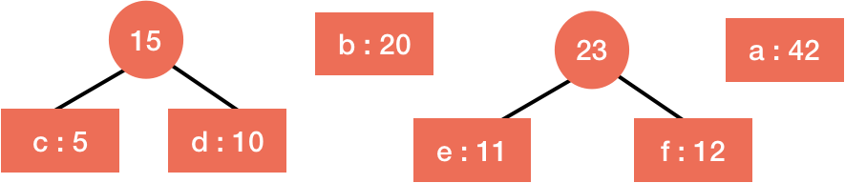
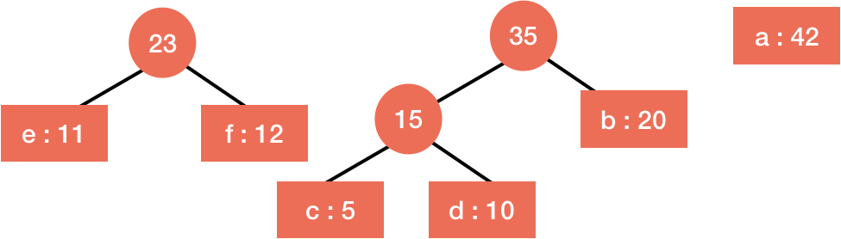
Construction of Binary Tree for Huffman Code, Encoding and Decoding
Example 1:
Character | Frequency
A | 42
B | 20
C | 5
D | 10
E | 11
F | 12

Slide 8
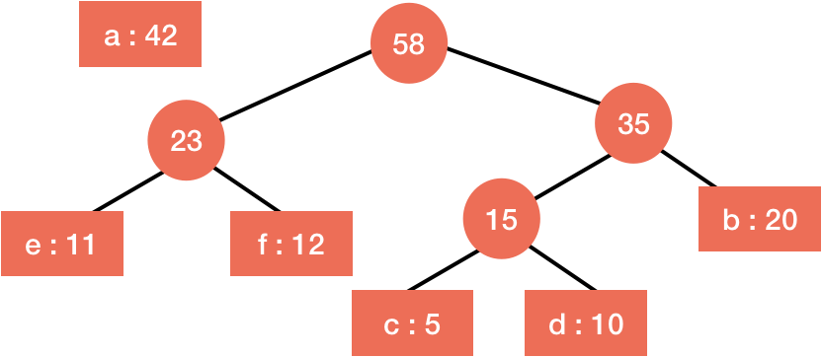
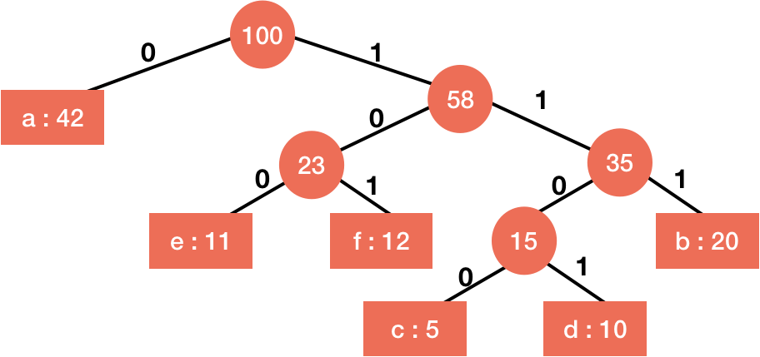
Encoding: As stated above, encoding is simple. We just have to concatenate the code of the characters to encode them. For example, to encode 'abc', we will just concatenate 0, 111 and 1100 i.e., 01111100.

Slide 9
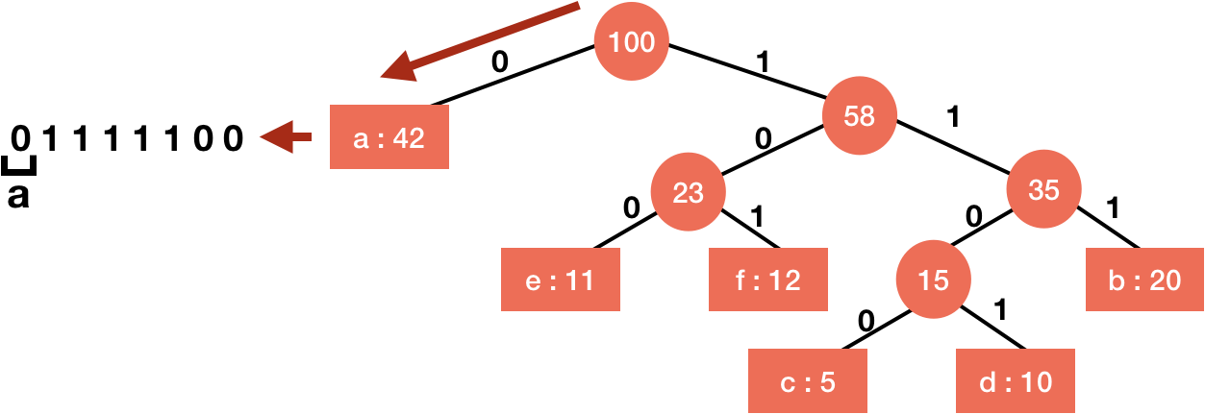
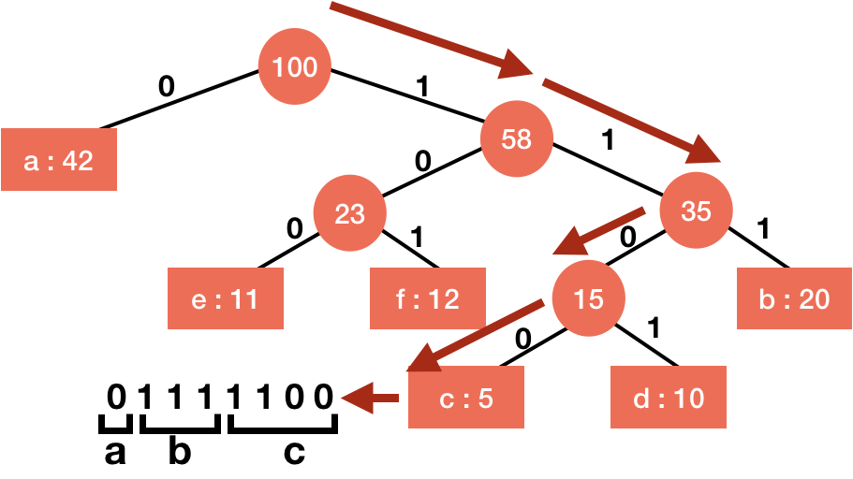
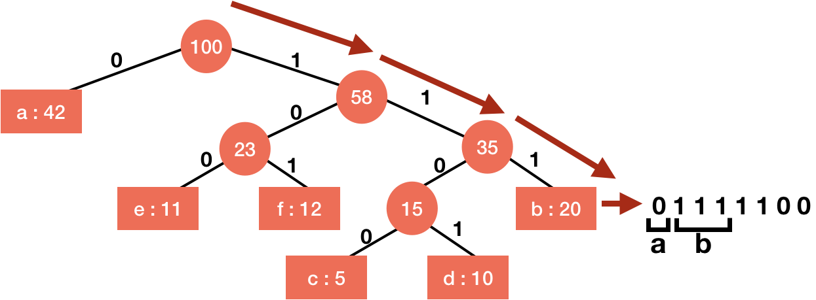
Decoding
Character | Frequency | Code
A | 42 | 0
B | 20 | 111
C | 5 | 1100
D | 10 | 1101
E | 11 | 100
F | 12 | 101

Slide 10
Example -2
A file contains the following characters with the frequencies as shown. If Huffman Coding is used for data compression, determine-
Huffman Code for each character
Average code length
Length of Huffman encoded message (in bits)
Characters Frequencies
a 10
e 15
i 12
o 3
u 4
s 13
t 1

Slide 11

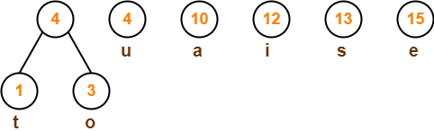
Solution
First let us construct the Huffman Tree.
Huffman Tree is constructed in the following steps-
Step-01:
Step-02:

Slide 12
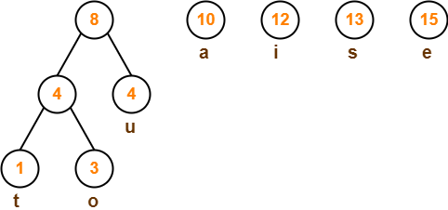
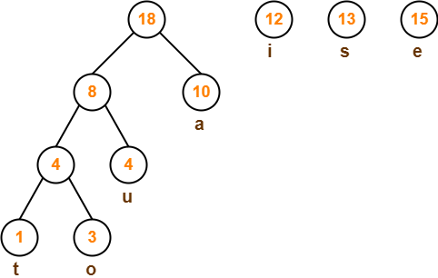
Solution
Step-03:
Step-04:

Slide 13
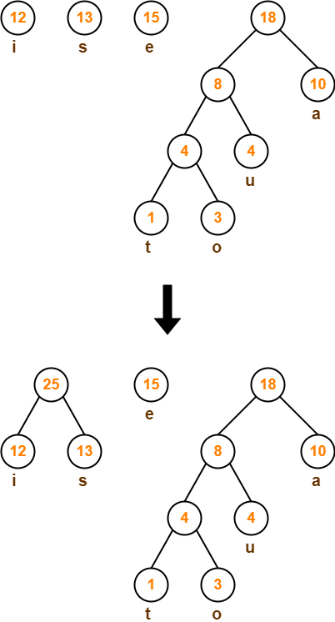
Step-05:

Slide 14
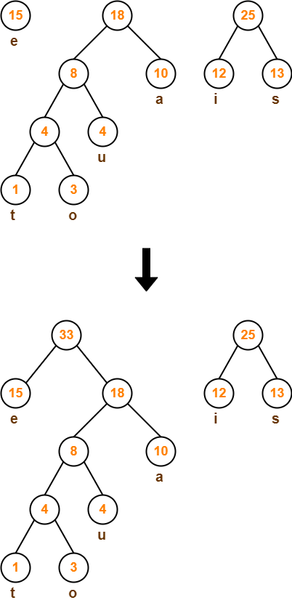
Step-06:

Slide 15
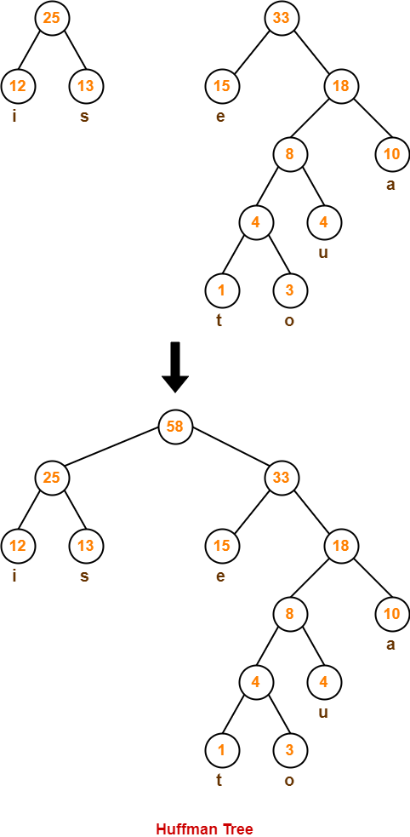
Spet -7

Slide 16
Now,
We assign weight to all the edges of the constructed Huffman Tree.
Let us assign weight ‘0’ to the left edges and weight ‘1’ to the right edges.
Rule If you assign weight ‘0’ to the left edges, then assign weight ‘1’ to the right edges. If you assign weight ‘1’ to the left edges, then assign weight ‘0’ to the right edges. Any of the above two conventions may be followed. But follow the same convention at the time of decoding that is adopted at the time of encoding.

Slide 17
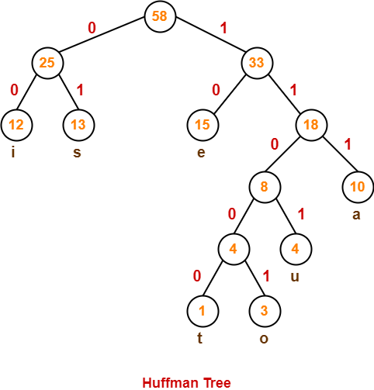
After assigning weight to all the edges, the modified Huffman Tree is-

Slide 18
1. Huffman Code For Characters
To write Huffman Code for any character, traverse the Huffman Tree from root node to the leaf node of that character.
Following this rule, the Huffman Code for each character is-
a = 111
e = 10
i = 00
o = 11001
u = 1101
s = 01
t = 11000
From here, we can observe
Characters occurring less frequently in the text are assigned the larger code.
Characters occurring more frequently in the text are assigned the smaller code.

Slide 19
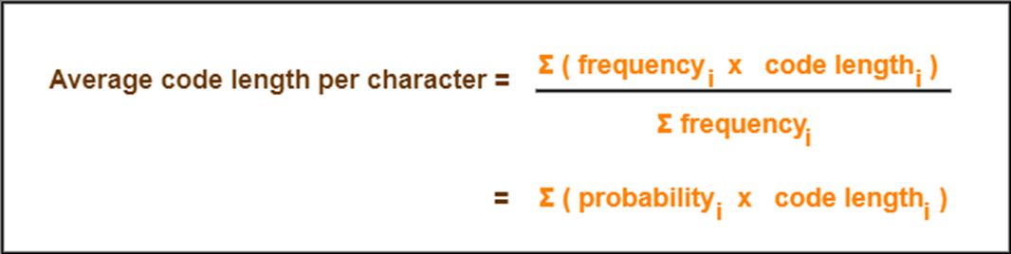
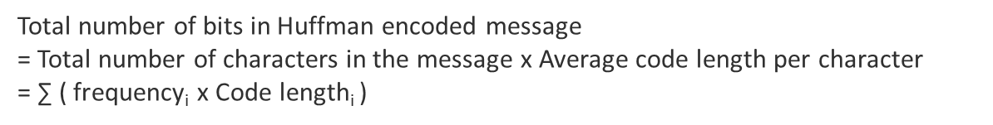
2. Average Code Length
Using formula-01, we have
Average code length
= ∑ ( frequencyi x code lengthi ) / ∑ ( frequencyi )
= { (10 x 3) + (15 x 2) + (12 x 2) + (3 x 5) + (4 x 4) + (13 x 2) + (1 x 5) } / (10 + 15 + 12 + 3 + 4 + 13 + 1)
= 2.52
3. Length of Huffman Encoded Message
Using formula-02, we have
Total number of bits in Huffman encoded message
= Total number of characters in the message x Average code length per character
= 58 x 2.52
= 146.16
≅ 147 bits

Slide 20
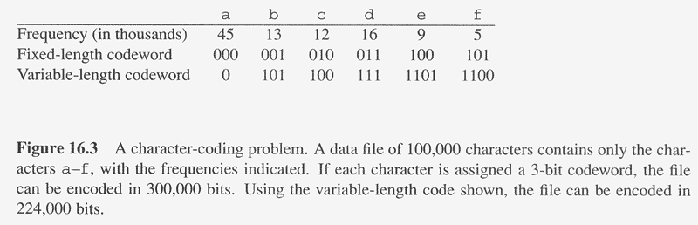
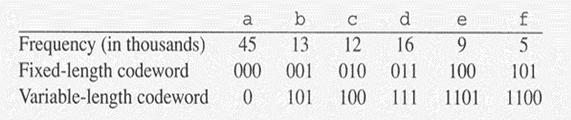
Example-3: Find Encoding codes for given characters
C: Alphabet
Two methods:
Fixed length coding
Variable Length coding(Huffman coding)

Slide 21
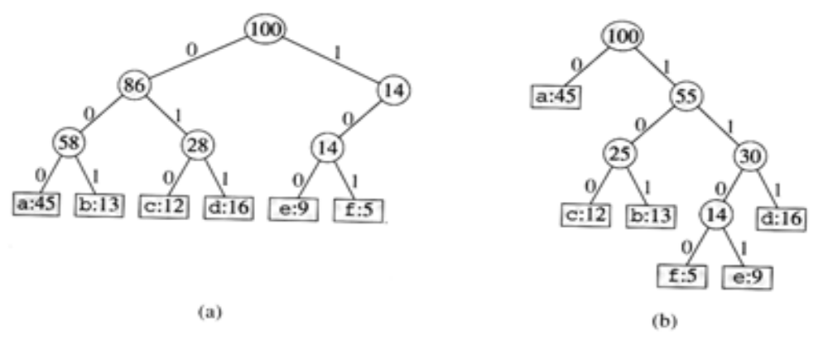
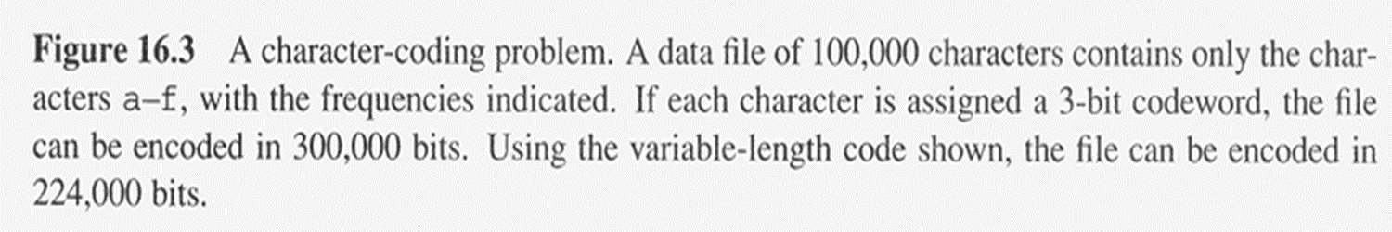
Trees for Fixed and Variable Length coding
Fig a: represents a fixed length encoding scheme
Fig b: represents a Huffman encoding scheme

Slide 22
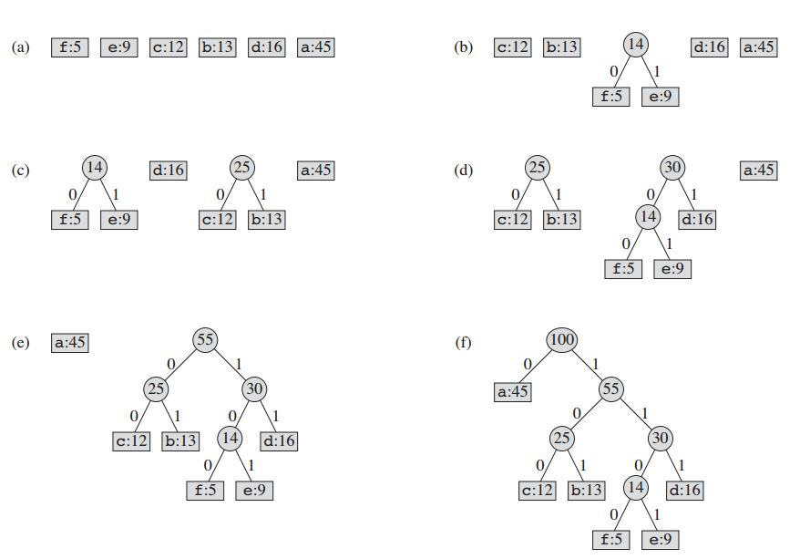
Construction of Huffman Encoding Tree

Slide 23
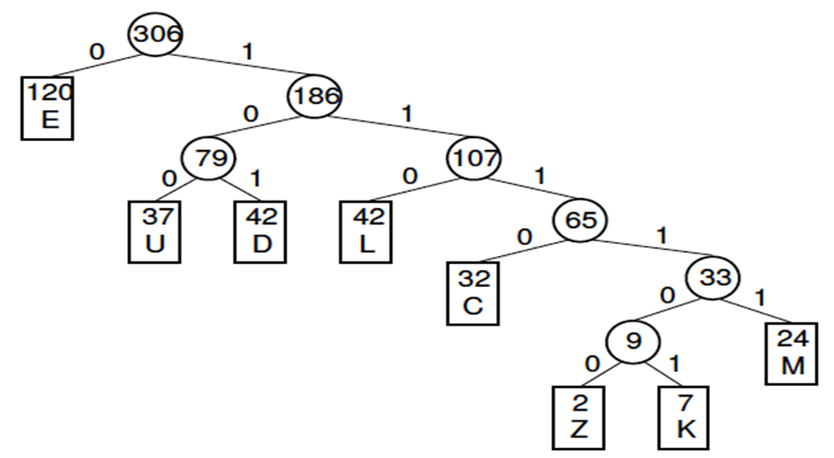
Example 4: Find Encoding codes for given characters
Letter | Z | K | M | C | U | D | L | E
Frequency | 2 | 7 | 24 | 32 | 37 | 42 | 42 | 120

Slide 24
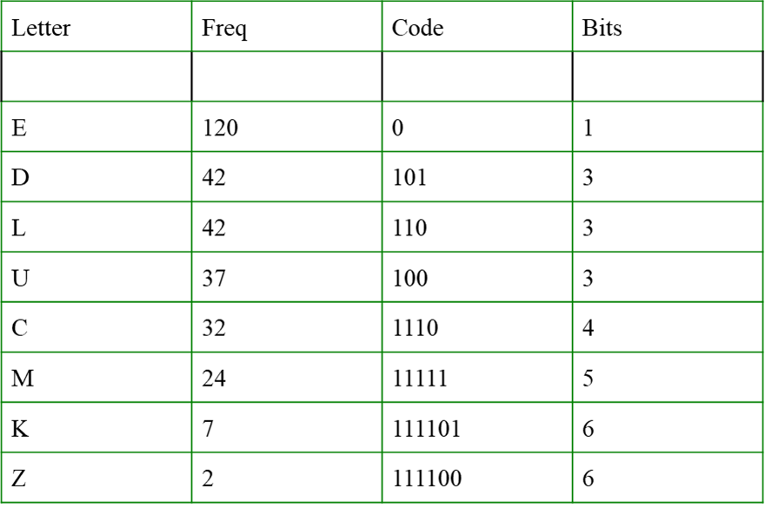
Huffman tree construction
Encoding
Encoding a string can be done by replacing each letter in the string with its binary code (the Huffman code).
Examples:
DEED 10100101 (8 bits)
MUCK 111111001110111101 (18 bits)
Decoding
Decoding an encoded string can be done by looking at the bits in the coded string from left to right until a letter decoded.
10100101 -> DEED

Slide 25
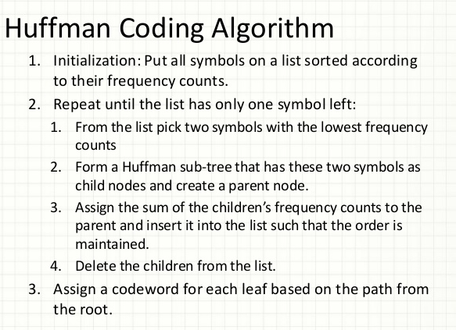

Slide 26
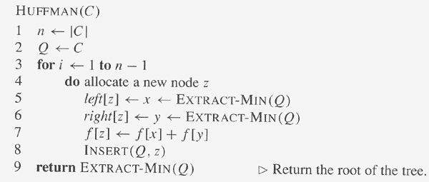
Algorithm: Constructing Huffman Code
// C is a set of n characters
// Q is implemented as a binary min-heap
O(n)
O(lg n)
O(lg n)
O(lg n)
Total computation time = O(n lg n)

Slide 27
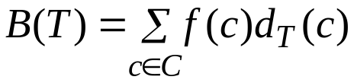
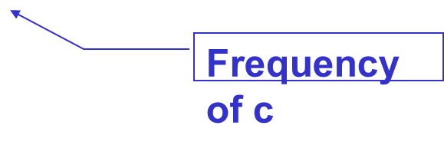
Cost of a Huffman Tree T
For each character c in the alphabet C
  let f(c) be the frequency of c in the file
  let d_{T}(c) be the depth of c in the tree
    It is also the length of the codeword. Why?
Let B(T) be the number of bits required to encode the file (called the cost of T)

Slide 28
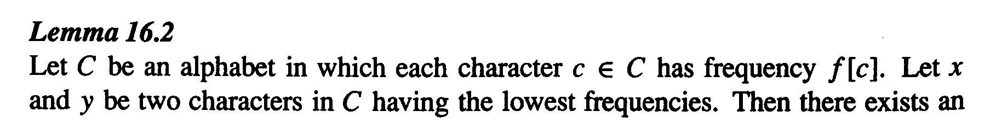
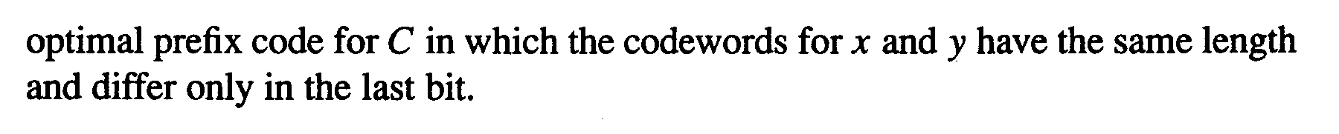
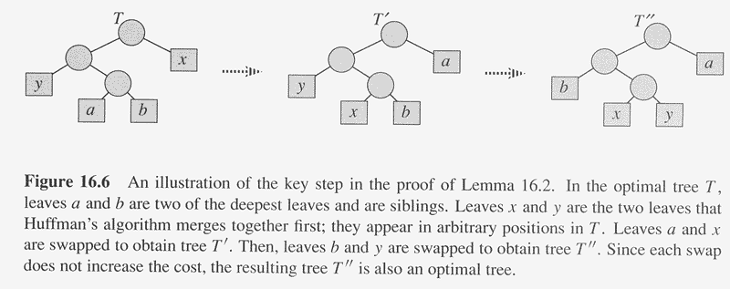
Correctness of Huffman’s Algorithm
Since each swap does not increase the cost, the resulting tree T’’ is also an optimal tree

Slide 29
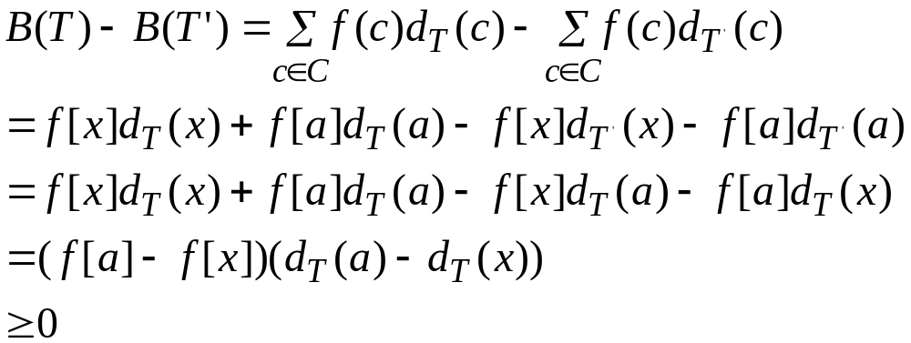
Lemma 16.2
Without loss of generality, assume f[a]≤f[b] and f[x]≤f[y]
The cost difference between T and T’ is
B(T’’) ≤ B(T), but T is optimal,
B(T) ≤ B(T’’) ➔ B(T’’) = B(T)
Therefore T’’ is an optimal tree in which x and y appear as sibling leaves of maximum depth

Slide 30
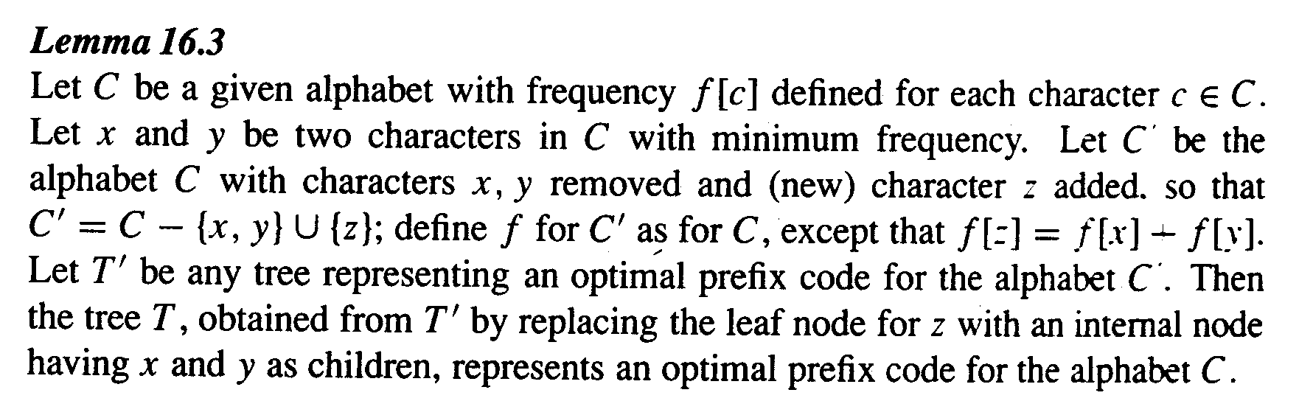
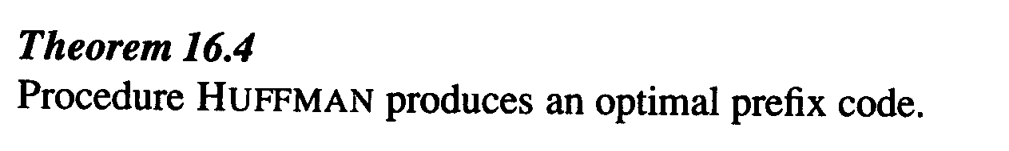
Correctness of Huffman’s Algorithm
Observation: B(T) = B(T’) + f[x] + f[y] ➔ B(T’) = B(T)-f[x]-f[y]
  For each c ∈C – {x, y} ➔ d_{T}(c) = d_{T’}(c)➔ f[c]d_{T}(c) = f[c]d_{T’}(c)
  d_{T}(x) = d_{T}(y) = d_{T’}(z) + 1
  f[x]d_{T}(x) + f[y]d_{T}(y) = (f[x] + f[y])(d_{T’}(z) + 1) = f[z]d_{T’}(z) + (f[x] + f[y])

Slide 31
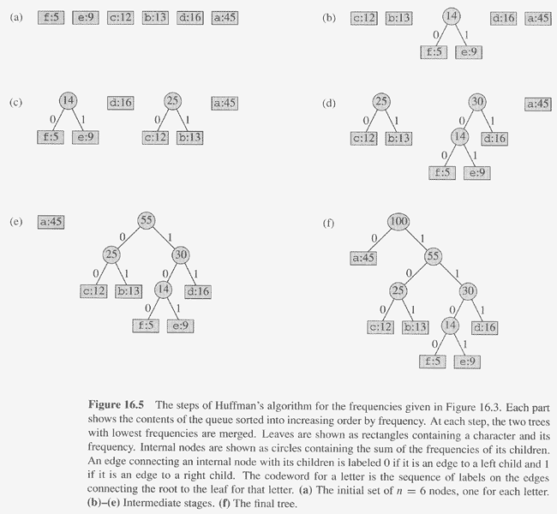
B(T’) = B(T)-f[x]-f[y]
z:14
B(T’) = 45*1+12*3+13*3+(5+9)*3+16*3
= B(T) - 5 - 9
B(T) = 45*1+12*3+13*3+5*4+9*4+16*3

Slide 32
Proof of Lemma 16.3
Prove by contradiction.
Suppose that T does not represent an optimal prefix code for C. Then there exists a tree T’’ such that B(T’’) < B(T).
Without loss of generality, by Lemma 16.2, T’’ has x and y as siblings. Let T’’’ be the tree T’’ with the common parent x and y replaced by a leaf with frequency f[z] = f[x] + f[y]. Then
B(T’’’) = B(T’’) - f[x] – f[y] < B(T) – f[x] – f[y] = B(T’)
  T’’’ is better than T’ ➔ contradiction to the assumption that T’ is an optimal prefix code for C’

Slide 33
Dynamic Programming vs. Greedy Algorithms
Dynamic programming
  We make a choice at each step
  The choice depends on solutions to sub problems
  Bottom up solution, from smaller to larger sub problems
Greedy algorithm
  Make the greedy choice and THEN
  Solve the sub problem arising after the choice is made
  The choice we make may depend on previous choices, but not on solutions to sub problems
  Top down solution, problems decrease in size

